Slide 1
py2store A DAO of Python
simple
& consistent
interfaces
to/from
complicated
&
varied
Tools to create
data systems.
Thor Whalen. Director of AI Research at Analog Devices
email: thor.whalen at analog
py2store repo: https://github.com/i2mint/py2store
A demo notebook for this talk: https://github.com/i2mint/examples/tree/master/pybay_2019

Slide 2
You can’t snore and dream at the same time. (*)
(*) http://davitzinc.blogspot.com/2015/07/fun-facts-can-you-snore-and-dream-at.html

Slide 3
Borelerplate and other creativity killers
They (*) say 80% of a data scientists time on data preparation.
Data prep? Accessing, cleaning, restructuring, generating more directly usable data.
Browser GUI
Desktop App
Mobile App
Command Line Interface
Once the data scientist did the extra 20% and is done, her work needs to be integrated…
API
Data Acquisition
Integrated in backend processes.
Provide a CLI
Make a web-service for it.
Provide a GUI
Edge Device
Explore,
Analyze & Model
Server (local or cloud)
Settings Control & model deployment
Storage
… and adapt to constant, never ending, incorrigible CHANGE.
(*) the internet

Slide 4
Does this process look familiar?
Configuration
Convention
What I have
What I want
make

Slide 5
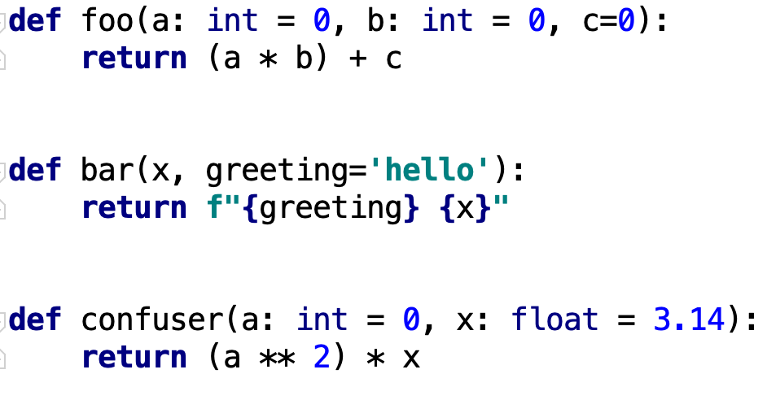
py2ui

Slide 6
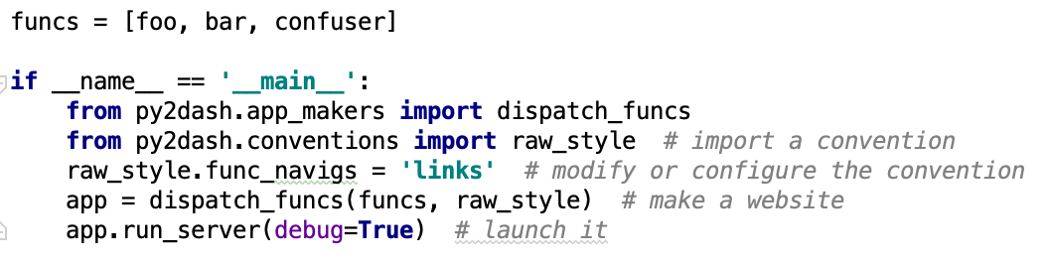
py2ui

Slide 7
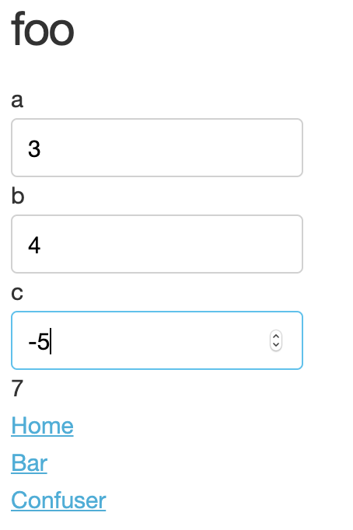
py2ui

Slide 8
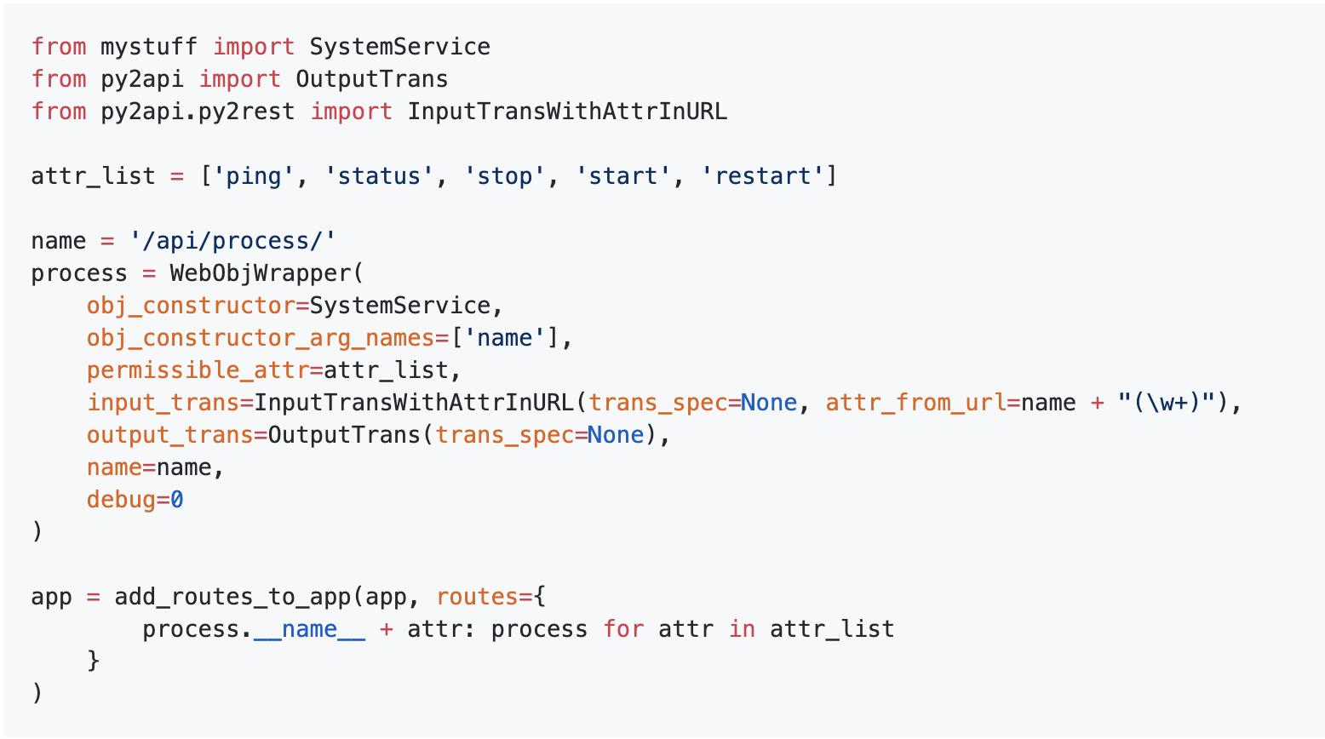
py2ws (when it’s easy)

Slide 9
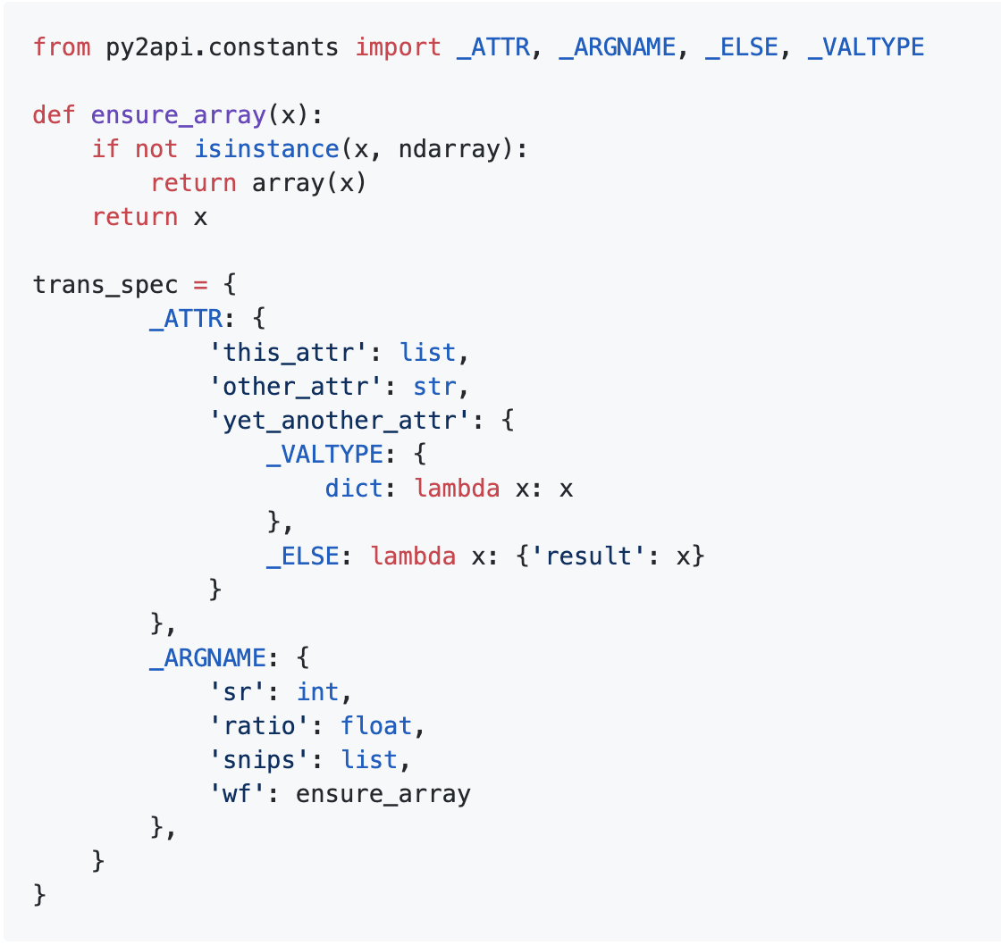
py2ws (when it’s harder)

Slide 10
The interface-to-interface view
Target
(e.g. webpage and webservices supporting it)
Source
Meta-interface
(e.g. signatures & docs)
Target
Meta-interface
(e.g. functions)
Source
(e.g. functions)
Conventions and configurations to get the specification of everything we need to generate the target

Slide 11
7 ± 2 (*)
(*) Miller, G. A. (1956). "The magical number seven, plus or minus two: Some limits on our capacity for processing information". Psychological Review (CiteSeerX 10.1.1.308.8071)

Slide 12
New words to make computers easier to use (*)
(*) Raymond Hettinger (PyBay 2019)

Slide 13
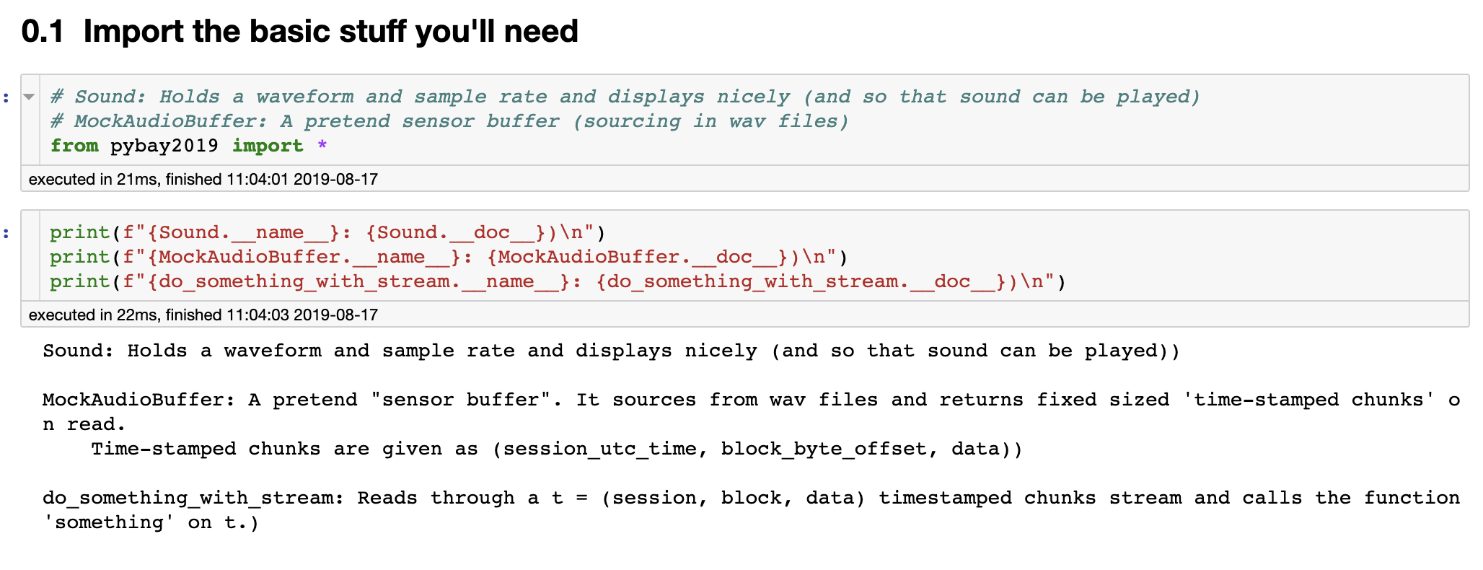
Based on a true story…

Slide 14
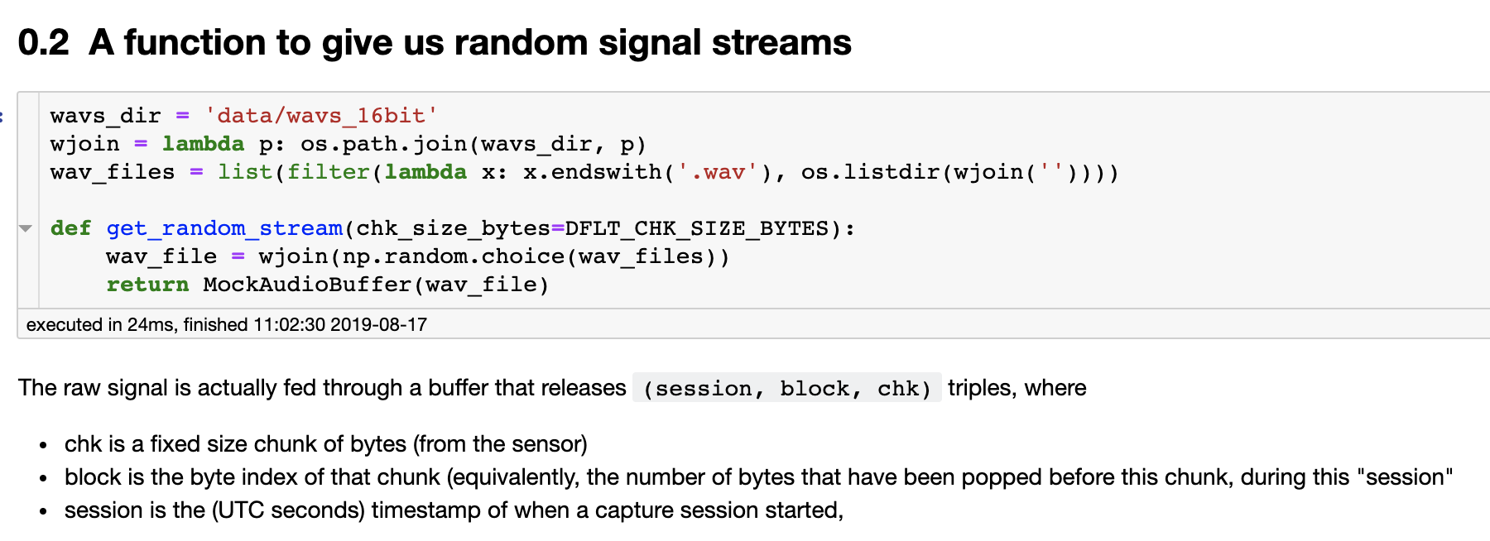
Based on a true story…

Slide 15
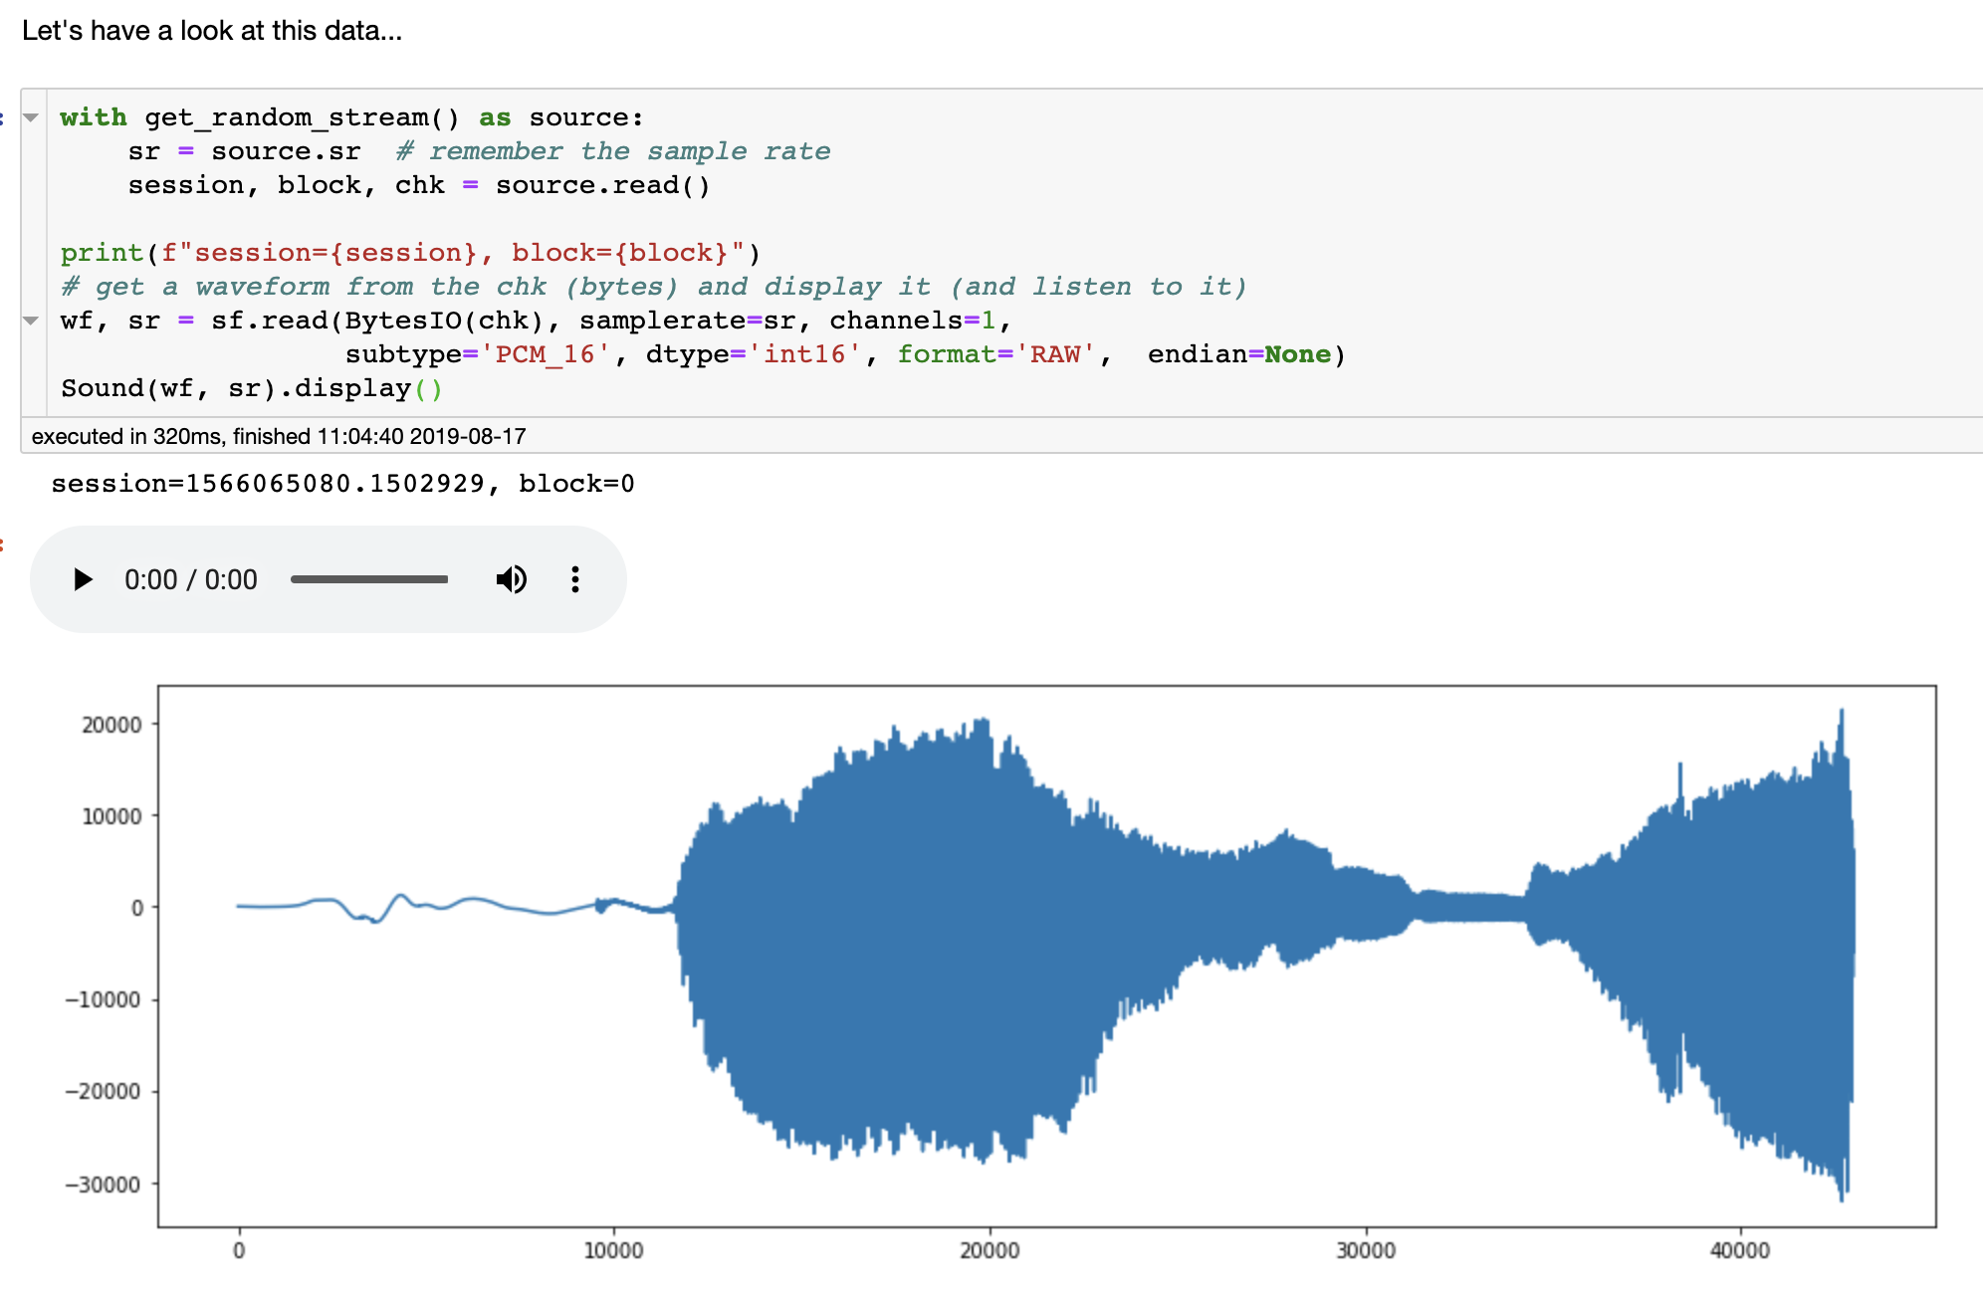
Based on a true story…

Slide 16
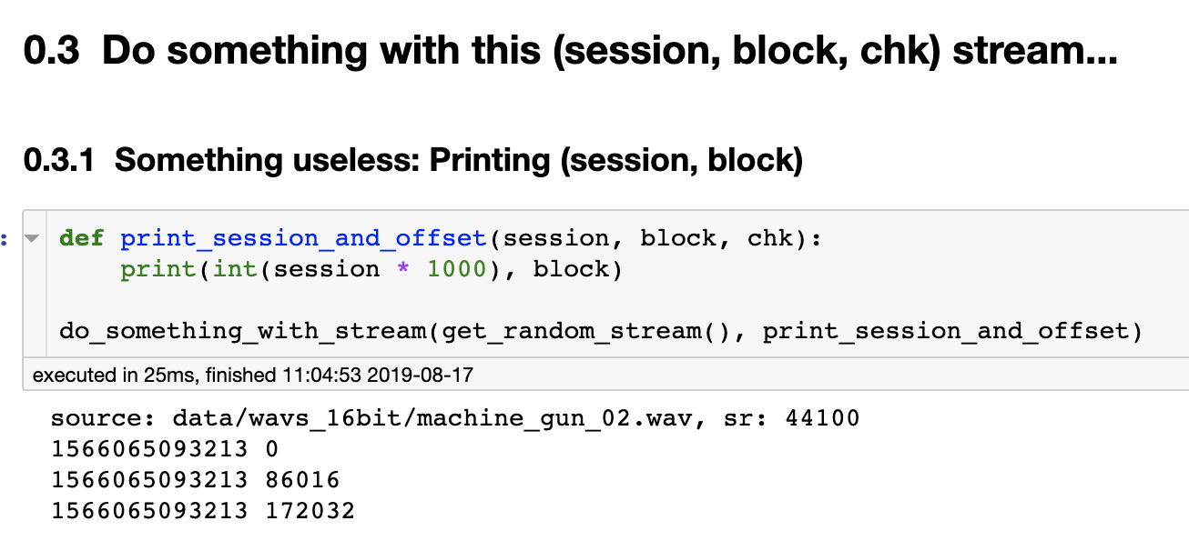
Based on a true story…

Slide 17
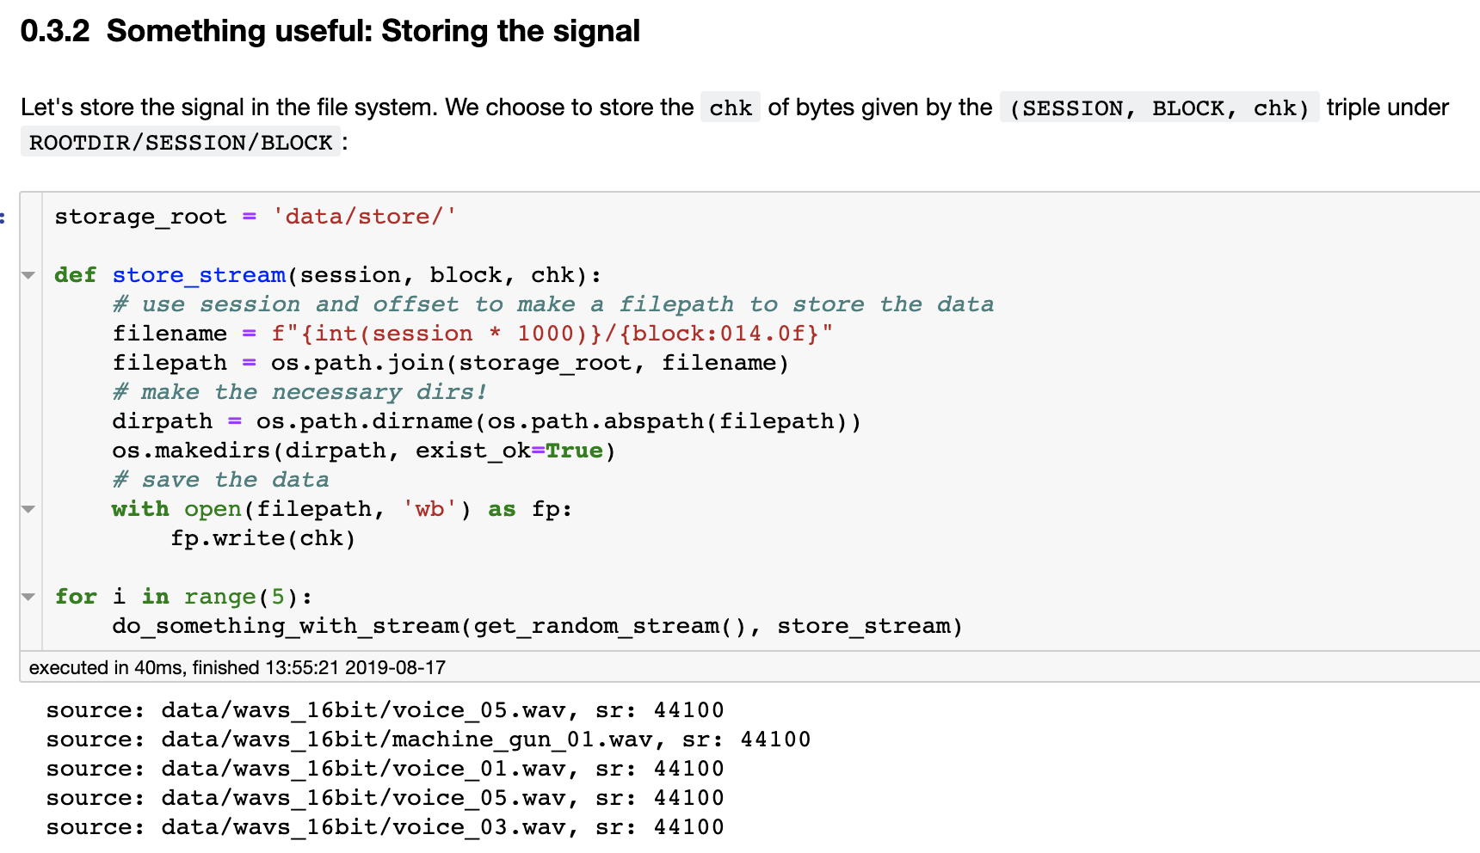
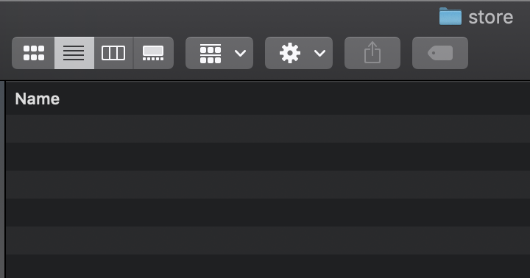
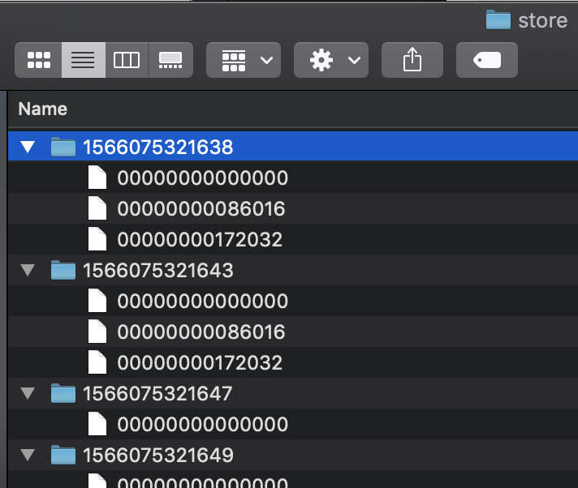
Based on a true story…

Slide 18
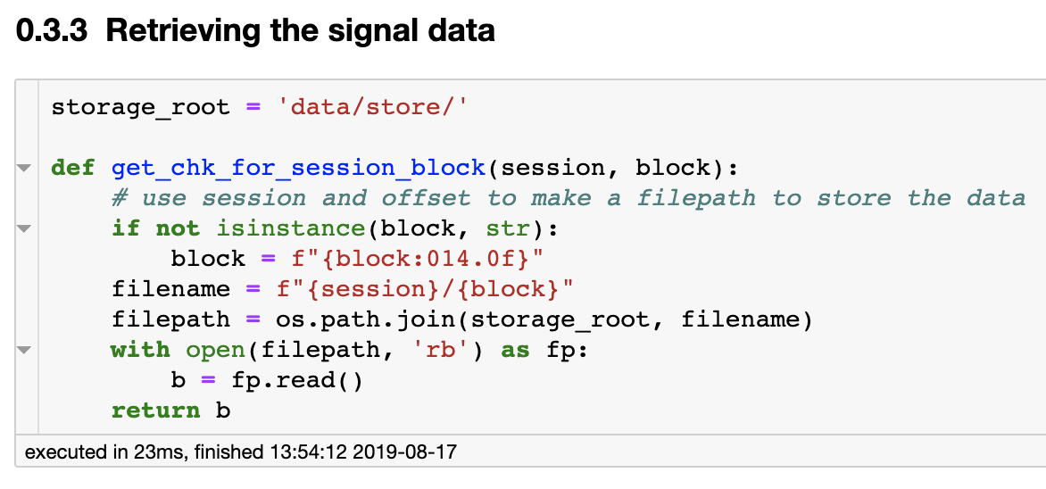
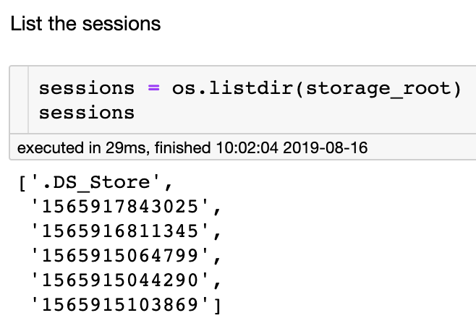
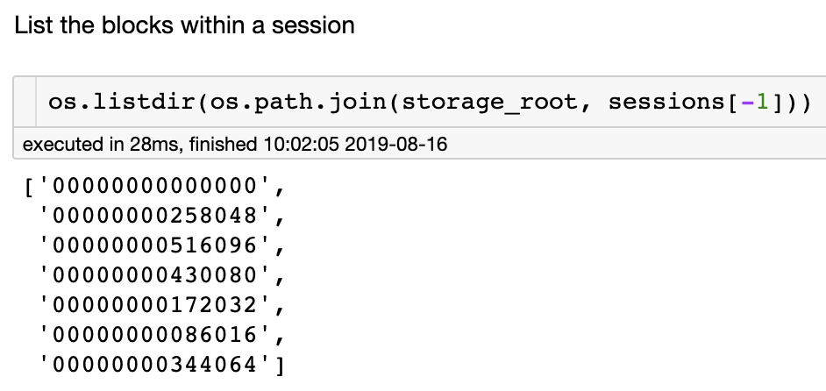
Based on a true story…

Slide 19
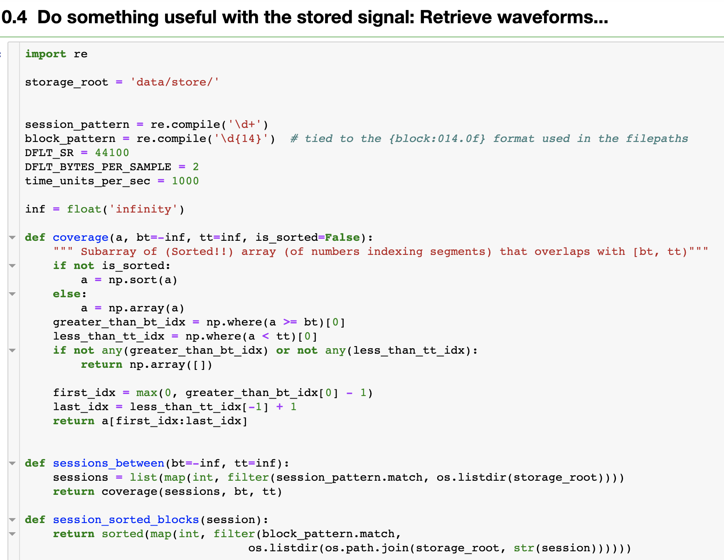
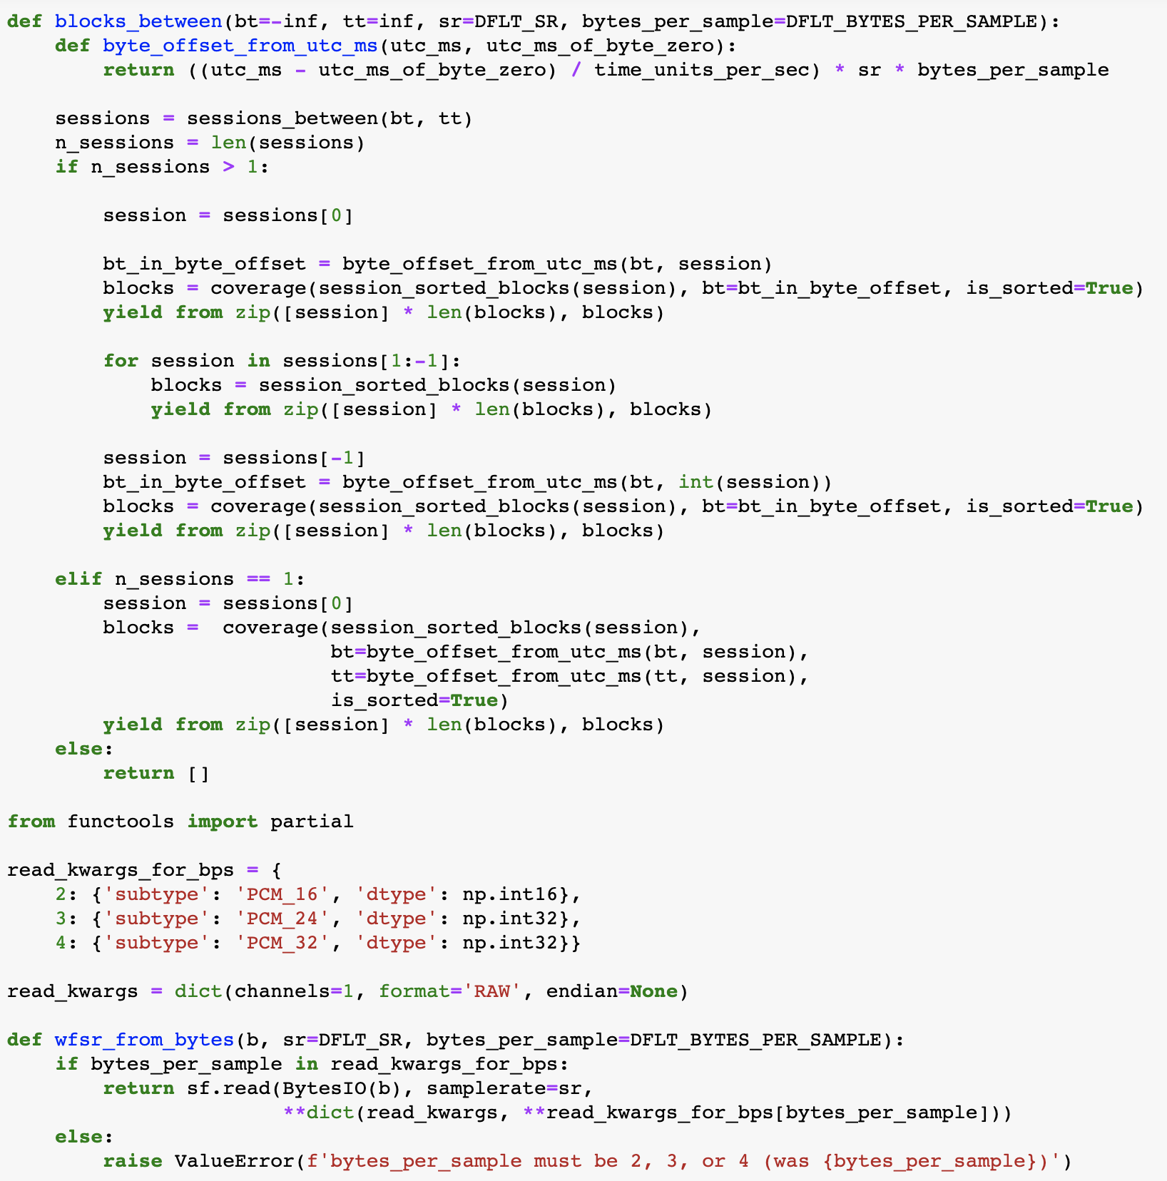
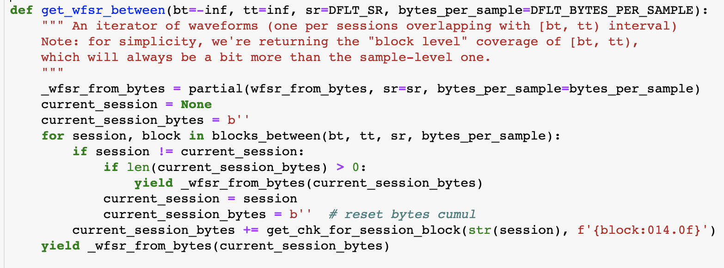
Can you spot all the places where the storage concern is involved?

Slide 20
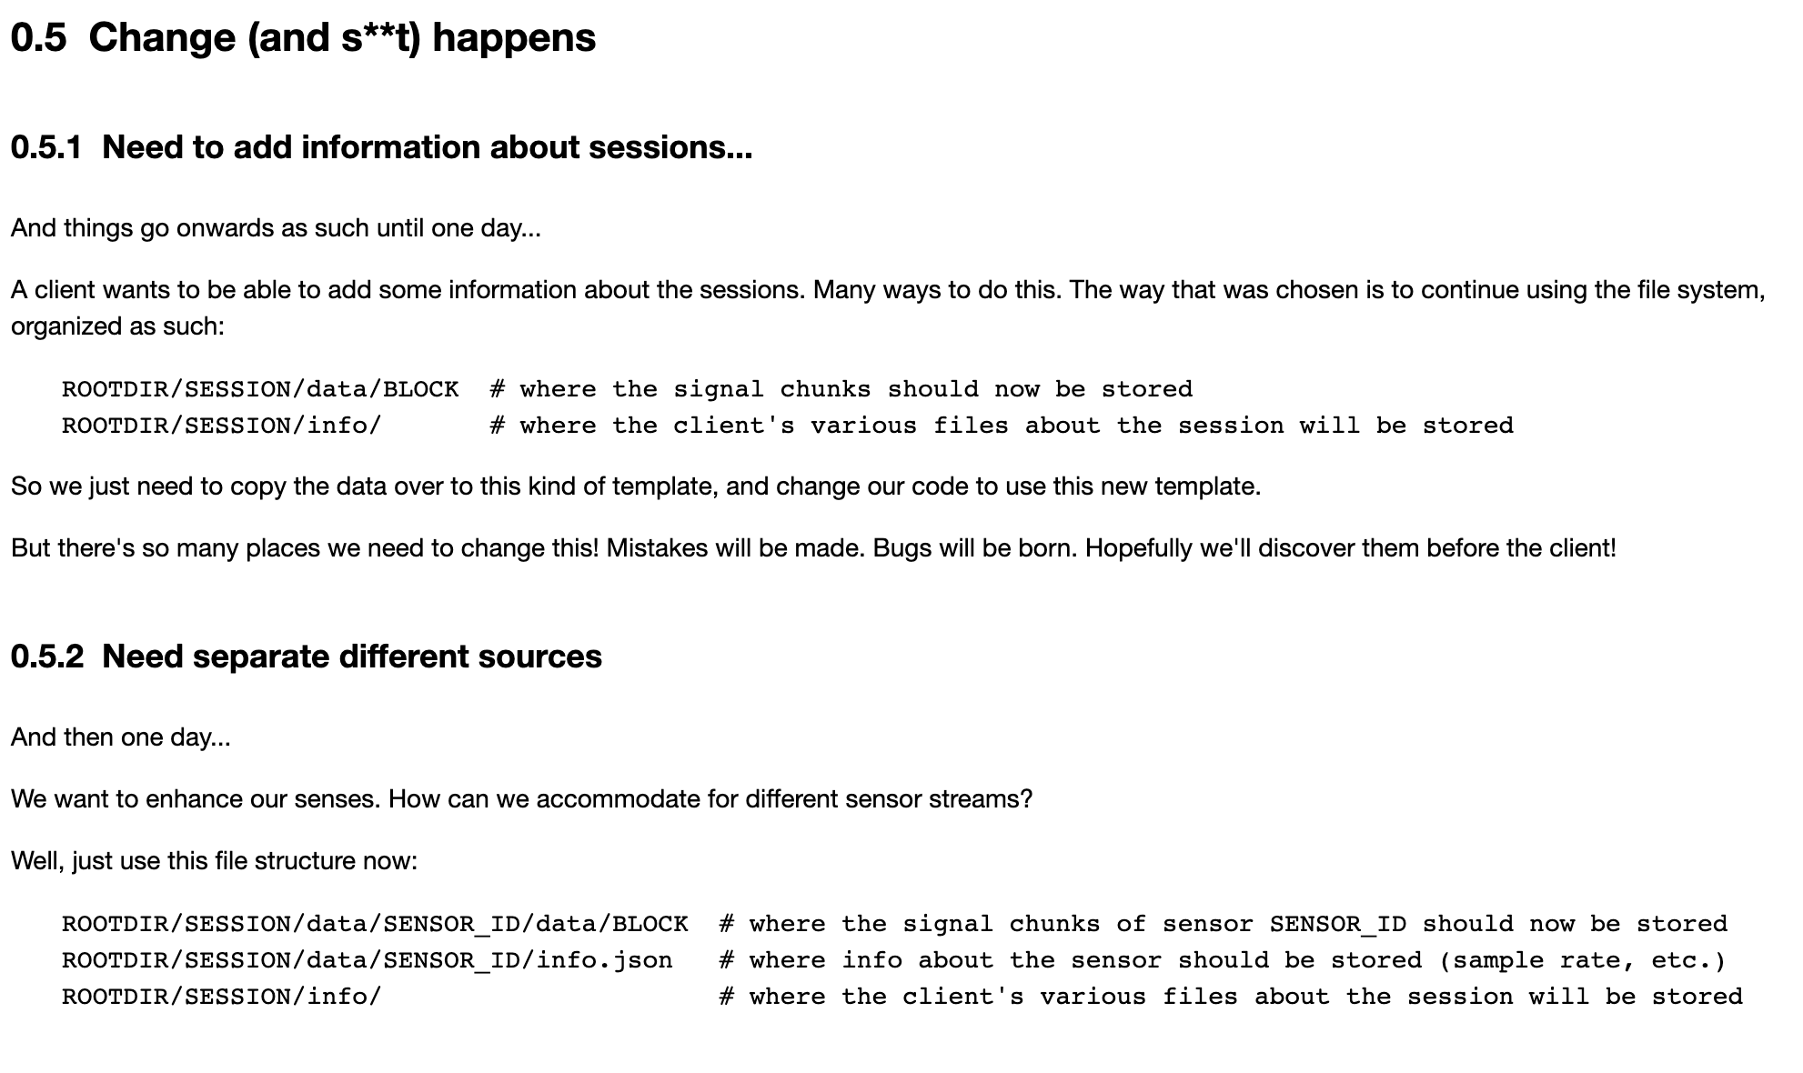
… and then, you need to adapt

Slide 21
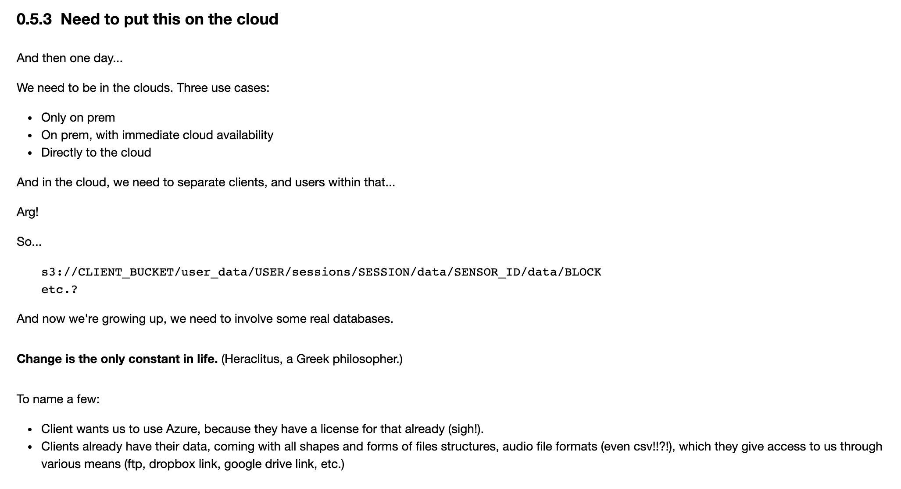
… again, and again, and again.

Slide 22
You can’t kill yourself by holding your breath (*)
(*) https://biology.stackexchange.com/questions/73866/why-cant-we-kill-ourselves-by-holding-our-breath

Slide 23
The solution? Nothing new: Just better design.
Code like this…
… so you can do this
Processes
DB
Processes
keymap
valmap
Processes
Other
DB
For those of you that ♡ acronyms: It’s not so much of an ORM as it is a DAO with a declarative SoC to be more DRY with storage.

Slide 24
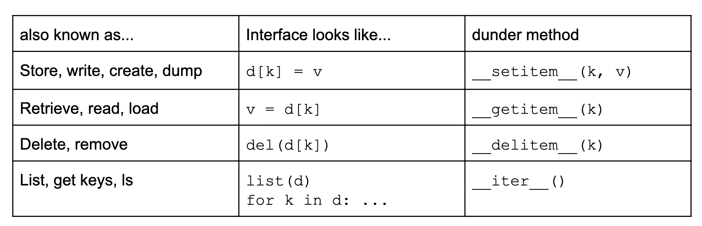
What operations should we focus on first?
And what should we call those operations.

Slide 25
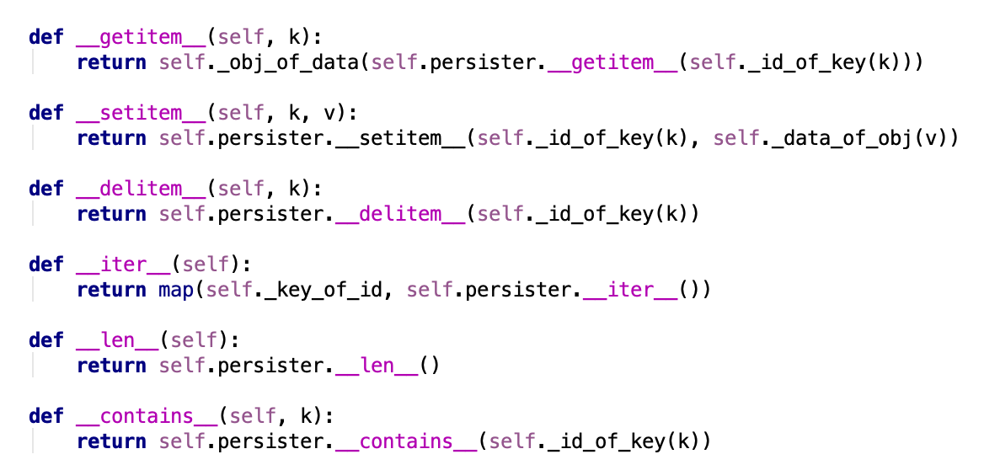

Slide 26
Wrapping input/output keys/values of data accessors
__getitem__
key
_id_of_key
_id
__getitem__
data
_obj_of_data
obj
__setitem__
key
_id_of_key
_id
__setitem__
obj
_data_of_obj
data
__delitem__
key
_id_of_key
_id
__delitem__
__iter__
__iter__
_id
_key_of_id
key

Slide 27
So far py2store focuses on a dict-like interface to the storage concern
Your base persister: What happens PHYSICALLY when you store
>>> persister = LocalFilePersister(root=‘/my/simpler/store’)
>>>
>>> keymap = LinearNaming('{session}/data/{block:014.0f}.wav’)
>>> >>> valmap = AudioBytes(
... sample_rate=44100, bit_depth=16, channels=1,
... dtype='int16', format='WAV’) >>> s = mk_store(persister, keymap, valmap)
Key Mapper: Indexing. The (2-way) mapping between the persister’s key format and the format YOU want to (or need to) use
Val Mapper: Serialization. The (2-way) mapping between the persister’s data format, and the object you get (you know, ORM stuff)

Slide 28
So now your code, no matter what the persister is, will look like this…
>>> len(s) 11 >>> list(s)[:3] ['/my/simpler/store/1566075321643/data/00000000000000.wav', '/my/simpler/store/1566075321643/data/00000000172032.wav', '/my/simpler/store/1566075321643/data/00000000086016.wav'] >>> >>> k = list(s)[0] >>> v = s[k] >>>
>>> b = get_microphone_bytes(4096)
>>> s[4, 20] = b # Store these bytes under (4,20)
>>> >>> v = s['/my/simpler/store/4/data/00000000000042.wav'] >>> type(v)
<class 'numpy.ndarray'> >>> len(v) 2048 >>> play_sound(v)

Slide 29
It’s a matter of this:
filename = f"{int(session * 1000)}/{block:014.0f}" filepath = os.path.join(storage_root, filename) # make the necessary dirs! dirpath = os.path.dirname(os.path.abspath(filepath)) os.makedirs(dirpath, exist_ok=True) # save the data with open(filepath, 'wb') as fp: fp.write(chk)

Slide 30
Versus that:
s[session, block] = chk

Slide 31
Or this:
filename = f"{int(session * 1000)}/{block:014.0f}" filepath = os.path.join(storage_root, filename) with open(filepath, 'rb') as fp: chk = fp.read() wf, sr = sf.read(BytesIO(chk), samplerate=sr,
channels=1, subtype='PCM_16', dtype='int16’, format='RAW', endian=None)

Slide 32
Versus that:
wf = s[session, block]

Slide 33
And when the time comes to store stuff somewhere else (S3, Mongo, SQL), with a different structure, or deal with a different data format or encoding…
Would you rather do this:

Slide 34
Or just modify a few things here?
persister = LocalFilePersister(root=‘/my/simpler/store’)
keymap = LinearNaming('{session}/data/{block:014.0f}.wav’)
valmap = AudioBytes(
sample_rate=44100, bit_depth=16, channels=1,
dtype='int16', format='WAV’) s = mk_store(persister, keymap, valmap)
And not have to touch ANYTHING in the “business logic” code.

Slide 35
In one slide…
Say you want (or need) to use the word “insert” to write some data associated to a user/device/channel triple…
Adapter combines user, device, and channel to make a unique key for it
s.insert(user, device, channel, data)
Adapter serializes the data object to something that the persistence layer can actually persist
Adapter translates “insert” to it’s internal write method name
Call
Adapter
s.__setitem__(key, val)
Persistence
Adapter
All adapter configurations are abstracted away so you can just write something somewhere and get on with more important stuff.
This is an example for writing, but the principle is the same for all other CRUD operations.
File System
SQL
S3
etc.
MongoDB
Dynamo
ElasticSearch

Slide 36
My email: thor.whalen at analog (or gmail)
py2store repo: https://github.com/i2mint/py2store
A demo notebook for this talk: https://github.com/i2mint/examples/tree/master/pybay_2019
Notes:
Close the gap between what we imagine and what is realized.

